Slide 1
Towards Automatic Grading of SQL Queries
Vijay Kumar Venkatamuniyappa
Major Professor:
Dr. Doina Caragea
Committee Members:
Dr. Torben Amtoft
Dr. Daniel Andresen

Slide 2
Introduction
Structured Query Language (SQL) is a standard language used to interact with relational databases
It is used in Database courses to introduce database concepts and to help practice them
Research Question: Can a tool be developed to automate the grading of SQL query assignments from database courses?

Slide 3
Overview
Previous works in automatic grading of SQL assignments
Architecture and roles of various technologies
Functionality and steps in parser
Project setup and usage
Demonstration
Evaluation result
Future developments

Slide 4
Previous works in grading SQL queries
ActiveSQL: Works by comparing the cells retrieved from the output in a test and hidden dataset
SQLify: System evaluation along with peer review
XData System: Works by extracting query clauses and comparing for the presence of expected clauses

Slide 5

Architecture
2. Syntax validation on database
3. Validation result and query output
Web browser
Web server
Database
1. User provides query
8. Database and Parsing-comparison output
4. SQL clause identification
5. JSON object of SQL query
9. Query submission
6. Compare with solution query
Query Parser
7. Comparison report
Persistent file storage
Solution Query
Notes:
Front-end
Webpage for student access to assignment questions, run SQL queries, view feedback and submit for grading
Persistent data storage
MySQL and Postgres databases
SQL query will be executed, and output will be returned
Assignment file
A Java Script Object Notation (JSON) containing assignment questions, answers, due date and tables for assignment
Submission file
JSON file that saves student query
Query Parser
Converts the SQL query into standard form in JSON type
Web server
Facilitates interaction and data transfer with all the components

Slide 6











Technologies
Notes:
Web server - Node.js
Database – PostgreSQL, MySQL
JSON
Frontend – HTML, CSS, Bootstrap, JavaScript, JQuery

Slide 7
Role of parser in evaluation
Converts the statements into a standard form
Parser output is used for evaluation and feedback
sql-parser
Tokenize and parses SQL queries to identify SQL expressions
SELECT * FROM `my_table` WHERE `foo` = 'bar’
node-sqlparser
SQL query is transformed into JSON form
{ type : ”select”, columns : ”*”, from : ”my_table”, where : ”foo=bar” }
Notes:
Converts the statements into a standard form
Let’s have a meeting tomorrow at 7:00 pm BST
{to: Carlos, event: meeting, time:7:00 pm, day: tomorrow}
{to: Bob, event: meeting, time:16:00 UTC, day: 2018/05/13}
{attendees: [‘Bob’, ’Alice’], event: meeting, time: 1526194800000}
How about we review of project 13th April right after noon break?
{to: Carlos, event: review, time: after noon break, day:13th April}
{to: Alice, event: meeting, time: 16:00 UTC, day:2018/05/13}
{attendees: [‘Bob’, ’Alice’], event: meeting, time: 1526194800000}
Parser output is used for evaluation and feedback

Slide 8
Limitation of node-sqlparser
Inability to parse SQL clauses such as:
Having
Inner query
Functions
Case expression
Using additional step to include these clauses

Slide 9
Steps in parsing SQL query
Pre-parsing step
Parsing and storing unhandled clauses into a store
Parsing by node-sqlparser
Post-parsing step
Use the values in store to create a complete JSON parsed string
select title, case ('released') when 1987 then 'before' when 1988 then 'same’ end as output from albums where released is not null group by title, released having released=1987 or released=1988;

Slide 10
Identifying SQL clauses
Regular expression | SQL clause
‘[^’]*’ | String identifier
\s+(true|false)\s+ | Boolean identifier
[0-9.]+ | Number identifier
[0-9A-Za-z_.$]+ | Column names
\(\s*select.*\) | Inner query
([\w$.]+)\((\s*[\w$.]+\s*,\s*)*\s*([\w$.]+){1}\s*\) | Function call
case\s.*when\s.*then\s.*end | Case statement
\s+(having)\s+ | Having clause

Slide 11
JSON structure
SQL Clause | JSON
Identity | { type : <type>, value : <value> }
Column name | { type : ‘column_ref’, table : <table_name>, column : <column_name> }
Table | { db : <db_name>, table : <table_name>, as : <alias> }
Select query | { type : ‘select’, distinct : null, columns : [ <expression> ] , from : [ <expression> ] , where : <binary_expressions> , groupby : [ <expressions> ] , orderby : [ <expressions> ] , limit : [<start_limit> [ , <end_limit> ] ] , params : [ <params_list> ] }
Function call | { type : ‘expr_func’ , name : <function_name> , args : [ <args_list> ] }
Inner query | { type : ‘inner_query’ , value : <json_query_expression> }
Having | { having : <binary_expressions> }
Case expression | { type: ‘case_expression’ , value : { value : <value> , cond_result : [ <sub_expressions> ] , default : <value> } }

Slide 12
Pre-parsing step - algorithm
function preParseQuery(query)
result = { query : query, store : new Map(), json : {}}
result ← replaceAllString(result)
result ← replaceNotNull(result)
result ← removeExtraSpaces(result)
result ← replaceFunctions(result)
result ← buildCaseJSON(result)
result ← reduceSubQuery(result)
json = nodeSQLParser.parse(json.query)
json.having = buildHavingJSON(json.query)
result.json ← json + json.having
return result

Slide 13
Pre-parsing step
{ type : 'select’, distinct : null,
columns : [ { expr : { type : 'column_ref’ , table : '', column : 'title’ }, as : null },
{ expr : { type : 'column_ref', table : '', column : 'rep_string_5’ }, as : 'output' } ],
from : [ { db : '', table : 'albums', as : null } ],
where : { type : 'binary_expr’, operator : 'IS’,
left : { type : 'column_ref', table : '', column : 'released' },
right : { type : 'column_ref', table : '', column : 'rep_string_3' } },
groupby : [ { type : 'column_ref', table : '', column : 'title’ }, { type : 'column_ref', table : '', column : 'released' } ],
orderby : null,
Limit : null,
params : [],
having : { type : 'binary_expr’, operator : '=‘,
left : { type : 'column_ref', table : '', column : 'released' },
right : { type : 'number', value : 1988 } } }
}

Slide 14
Pre-parsing step
Map {
'rep_string_0' => { type : 'string', value : '\'released\'' },
'rep_string_1' => { type : 'string', value : '\'before\'' },
'rep_string_2' => { type : 'string', value : '\'same\'' },
'rep_string_3' => { type : 'not null', value: 'not null' },
'rep_string_4' =>
{ type : 'expr_func', name: ‘’, args : [ { type : 'column_ref', table : '', column : 'rep_string_0' } ] },
'rep_string_5' =>
{ type : 'case_expr’, value : { value : { type : 'column_ref', table : '', column : 'rep_string_4' },
cond_result : [ { condition : { type : 'number', value : '1987’ }, result : { type : 'column_ref', table : ‘’, column : 'rep_string_1' } }, { condition : { type : 'number', value : '1988’ },
result : { type : 'column_ref’, table : '', column : 'rep_string_2' } } ],
default : null } }
}

Slide 15
Post-parsing step - algorithm
function postParseQuery(clause)
if clause.type = identity then
return clause.value
else if clause.type = "column_ref" then
clause.type = postParseQuery(clause.value)
return clause
else if clause.type = "binary_expr" then
clause.right = postParseQuery(clause.right)
clause.left = postParseQuery(clause.left)
return clause
else if clause.type = "expr_list" then
for var subClause in clause.value do
subClause = postParseQuery(subClause)
return clause

Slide 16
Post-parsing step
{ type : 'select’, distinct : null,
columns : [ { expr : { type : 'column_ref', table : '', column : 'title’ }, as : null },
{ expr : { type : 'case_expr', value : [Object] }, as : 'output' } ],
from : [ { db : '', table : 'albums', as : null } ],
where : { type : 'binary_expr’, operator : 'IS’,
left : { type : 'column_ref', table : '', column : 'released' },
right : { type : 'not null', value: 'not null' } },
groupby : [ { type : 'column_ref', table : '', column : 'title’ }, { type : 'column_ref', table : '', column : 'released' } ],
orderby : null,
limit : null,
params : [],
having : { type : 'binary_expr’, operator : '=‘,
left : { type : 'column_ref', table: '', column : 'released' },
right : { type : 'number', value : 1988 } }
}

Slide 17
Evaluation Step
Syntax check
Syntax error in query will be revealed when executed on a database
Output verification
Comparing the output of the query
Match the output of query with the expected output
SQL clauses validation using the parsed JSON
JSONs of both queries compared with respect to clauses to identify correctness

Slide 18
Project setup
Project is available to clone from Git repository
Requires Node.js and database connection
Node package manager module to install and run the project
$ git clone https://github.com/vijaykumardev/SQLAutoGrader .git
$ cd .git
$ npm install
$ npm start

Slide 19
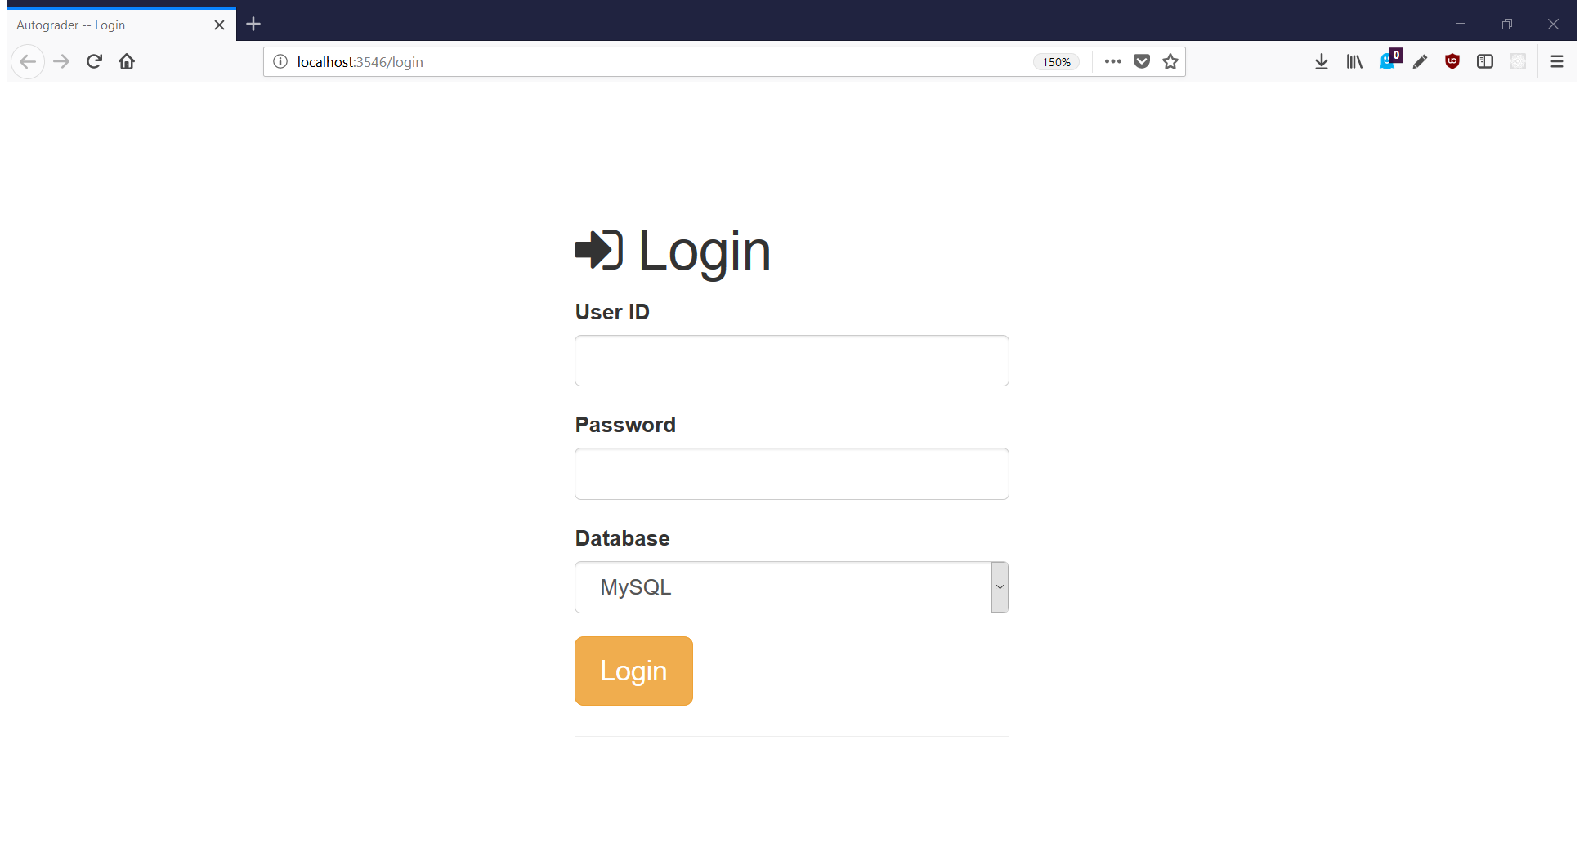
Demonstration

Slide 20
Demonstration
author_id | author_name | born | died | nationality
A0001 | George S. Clason | 1874 | 1957 | USA
A0002 | Paulo Coelho | 1947 | null | Brazil
A0003 | Viktor E. Frankl | 1905 | 1997 | Austria
A0004 | C. Rajagopalachari | 1878 | 1972 | India
A0005 | Joseph Conrad | 1857 | 1924 | Russia
A0006 | R. K. Narayan | 1906 | 2001 | India
publisher_id | publisher_name | address | website
P0001 | Harper Collins | USA | www.harpercollins.com
P0001 | Harper One | USA | www.harperone.com
P0001 | Verlag fur Jugend und Volk | Austria | null
P0001 | Indian Thought Publications | India | null
P0001 | Blackwood's Magazine | England | null
P0001 | Bharatiya Vidya Bhavan | India | bhavanus.com
P0001 | Bharatiya Vidya Bhavan | India | bhavanus.com
book_id | author_id | title | genre | publisher_id | isbn_no | published_date
B0001 | A0001 | The Richest Man In Babylon | finance | null | 451205367 | 1926
B0002 | A0002 | The Alchemist | fiction | P0002 | 62315005 | null
B0003 | A0003 | Mans search for meaning | psychology | P0003 | 807014295 | 1946
B0004 | A0006 | Malgudi Days | short stories | P0004 | 8185986177 | 1943
B0005 | A0005 | Heart of Darkness | fiction | P0005 | null | 1899
B0006 | A0004 | Mahabharata | religion | P0006 | 8172763689 | 1951
B0007 | A0004 | Ramayana | religion | P0006 | 8172763654 | 1951

Slide 21
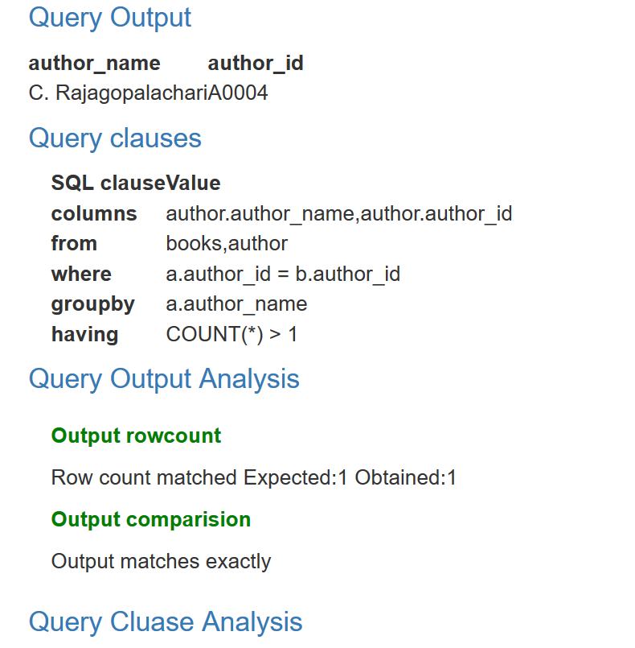
Demonstration
Find the authors who have published more than one book
select author.author_name from books,author where author.author_id = books.author_id group by books.author_id, author.author_name having count(*)>1;
select a.author_name, a.author_id from books b,author a where a.author_id = b.author_id group by a.author_name having count(*)>1;

Slide 22
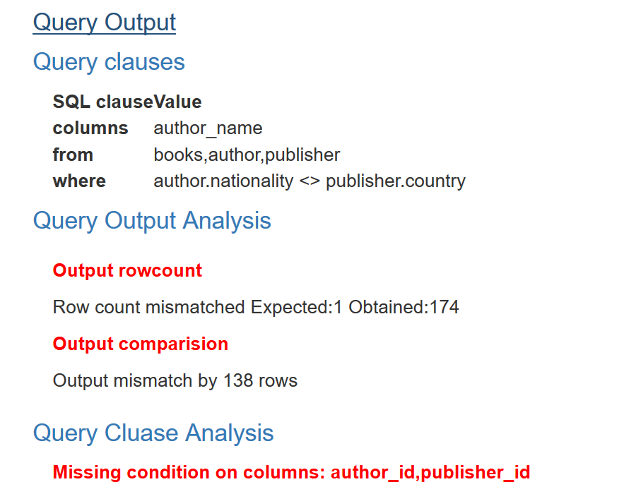
Demonstration
Books published outside authors home country
select author_name from books, author, publisher where books.author_id = author.author_id and publisher.publisher_id=books.publisher_id and author.nationality <> publisher.country;
select author_name from books, author, publisher where author.nationality <> publisher.country;

Slide 23
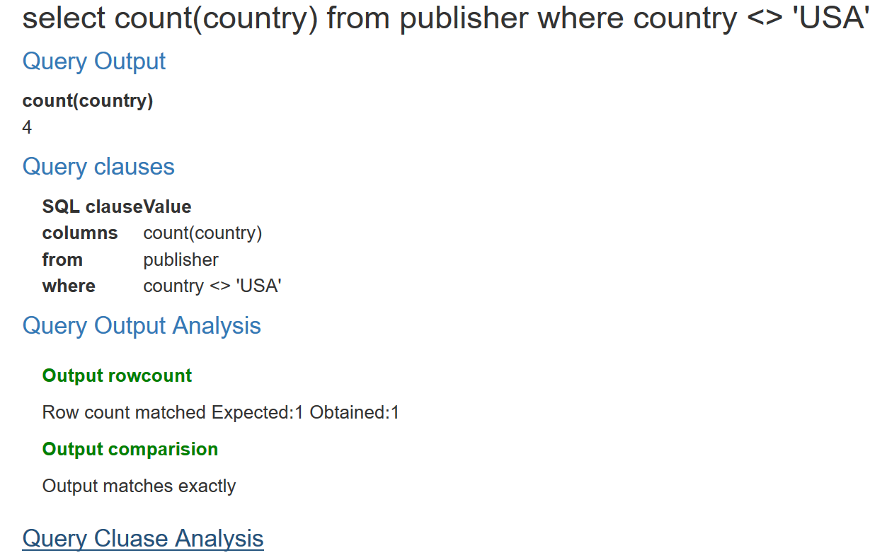
Demonstration
Find the number of international publisher
select count(publisher_id) from publisher where country != 'USA’;
select count(country) from publisher where country <> 'USA';

Slide 24
Evaluation result
Class | Query count
Total queries | 120
Syntax error | 2
Parser error | 30
True positive | 62
False positive | 0
False negative | 5
True negative | 21

Slide 25
Future works
Currently the tool can’t process clauses like union, intersect, except, in – this limitation can be addressed in the future
Fix parser error in aggregate function, alias name, asterisk symbol “*”
Enhance query feedback with performance suggestions
Improve user interface

Slide 26
Conclusion
Demonstrated the method of evaluating SQL query using a parser
With faster feedback on submissions, this guides students to concentrate their time and effort on learning than on administrivia

